Slide 1

Final project:
European Soccer Analysis

Slide 2
Introduction
Project Introduction:
This project explores the European Soccer Database, which contains detailed match and player statistics from various European football leagues between 2008 and 2016. The aim is to analyze match outcomes, team performance, and player contributions using statistical and machine learning techniques.
Motivation:
The motivation behind choosing this project lies in the popularity and richness of soccer data, which provides an ideal playground for applying data analysis and predictive modeling. Soccer combines tactical complexity with large-scale fan engagement, making it a compelling domain to explore insights, predict match outcomes, and evaluate player/team performance using real-world data.

Slide 3
2. Project Overview
Description: This project utilizes the European Soccer Database, which includes match results, team attributes, player statistics, and league information across several European leagues from 2008 to 2016. It applies data analysis, visualization, and machine learning techniques to extract insights and build predictive models related to football matches and team performance.
Source: Kaggle – European Soccer Database (2008–2016), Sqlite Database
Contents: Sql Table: Match, Country,League,Player_Attributes,Player,Team,Team_Attributes
Volume:
25 979 matches
11,060+ players
299 teams
Key columns: date, home/away team, score, team attributes, bookmaker odds
Data cleaning performed:
Removed missing values (e.g., players without attributes)
Joining tables for queries (matches, teams, players, bookmakers)
Transformed variables (encoding, normalization) for machine learning
Cleaning performed:
Removed rows where all player fields are missing (home_player_1 to home_player_11, same for away team,etc…).
Removed rows where all match statistics (goals, shots, fouls, etc.) are null.
Removed rows without bookmaker odds (B365, BW, WH, etc.).
Removed duplicates.

Slide 4
Purpose and Objectives:
To understand patterns in team and player performance over time.
To build predictive models for match outcomes (win, loss, draw).
To identify key factors that influence match results and player impact.
To visualize trends in performance, discipline, and strategy across leagues.

Slide 5
Real-Life Problems Addressed:
Match Outcome Prediction: Useful for clubs, analysts, and betting companies to forecast results based on historical data.
Player and Team Evaluation: Helps coaches and scouts identify high-performing players and effective team strategies.
Fan Engagement: Provides data-driven insights that can enhance fan experience and media content.
Decision-Making Support: Assists club managers in tactical and transfer decisions based on performance metrics.

Slide 6
3.Project Objectives
Project Objectives
Identify performance factors in European football matches
Predict match outcomes: win, draw, or loss
Analyze team and player trends across multiple seasons
Create interactive visualizations accessible to all

Slide 7
3. Feature Correlations / Machine Learning
Explored correlations (planned for the next phase of the project):
Bookmaker odds (B365H, B365D, B365A) and match outcome.
Match statistics (goals, shots on target, corners, possession) and final result.
Machine Learning Models Used:
Random Forest Classifier
Objective: Predict match outcome (home win / draw / away win)
Trained on: Selected and normalized variables
Evaluation: accuracy_score, classification_report, confusion matrix
Result: Accuracy score around X% (to be specified based on output)
- KMeans Clustering
Objective: Group teams into 4 clusters based on attributes (after PCA and normalization)
Used for: Visualizing similar team profiles
Final visualization: Scatter plot of teams projected into the reduced space

Slide 8
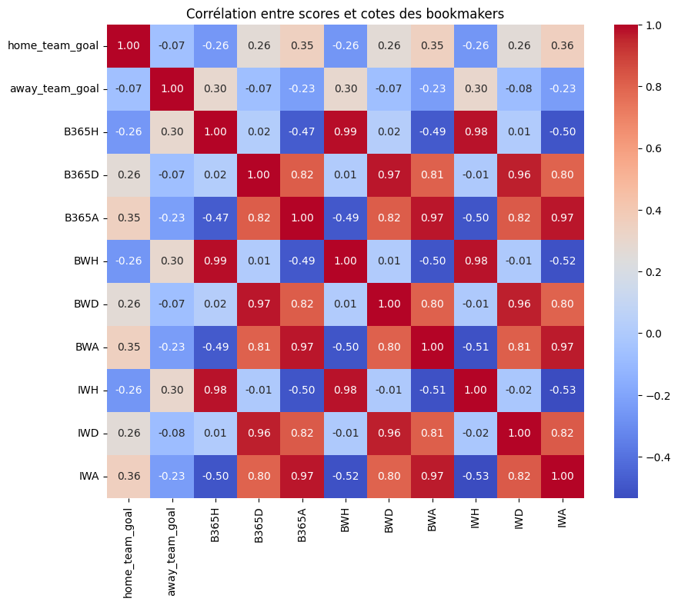
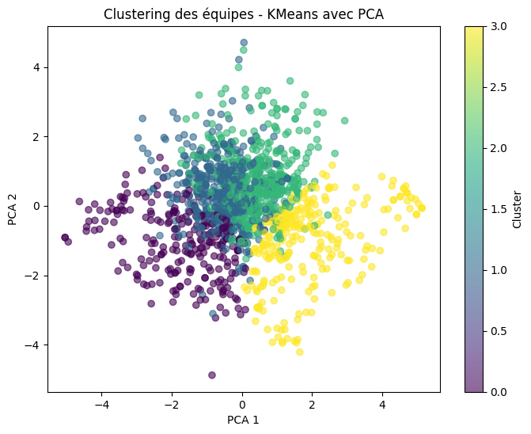
Results

Slide 9
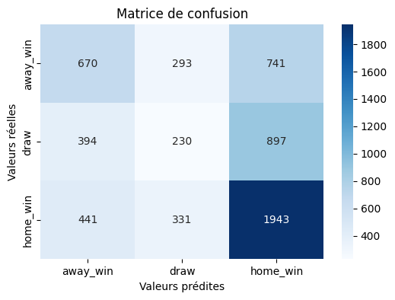
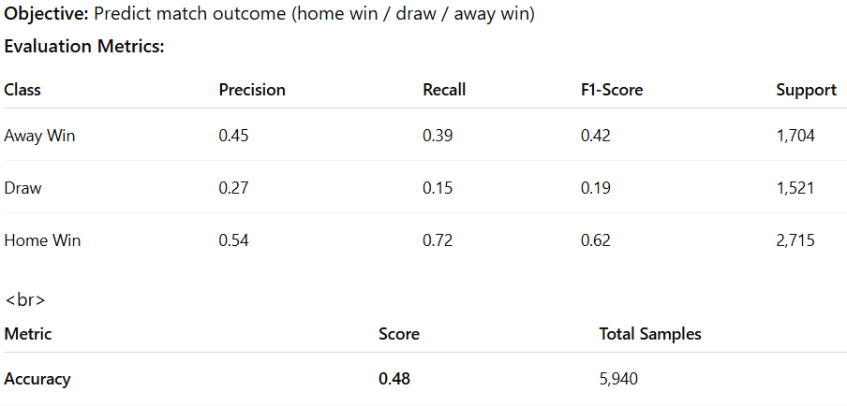
Random Forest Classifer

Slide 10
4. Limits
4. Limitations
Project limitations:
Data stops at 2016 → does not reflect current dynamics.
XML columns (goal, shoton, etc.) require additional parsing (not handled here).
Many null values → significant data loss after heavy cleaning.
No enrichment with recent or contextual data (injuries, weather, etc.).
Possible improvements:
Parse nested XML columns.
Add recent data via API (e.g., football-data.org).

